Slide 1


Slide 2
TABLE OF CONTENTS
SNO | CONTENT
1 | ABSTRACT
2 | EXISTING SYSTEM
3 | DISADVANTAGES OF EXISTING SYSTEM
4 | PROPOSED SYSTEM
5 | ADVANTAGES OF PROPOSED SYSTEM
6 | HARDWARE REQUIREMENTS
7 | SOFTWARE REQUIREMENTS
8 | SYSTEM ARCHITECTURE
9 | DATA FLOW DAIGRAM
10 | MODULES
11 | UML DIAGRAMS
12 | SAMPLE CODE
13 | RESULT
14 | CONCLUSION
15 | FUTURE ENHANCEMENTS AND REFERENCES

Slide 3
ABSTRACT :
Bitcoin is a crypto currency which is used worldwide for digital payments.
Bitcoin is decentralized i.e. it is not owned by anyone.
Transactions made by Bitcoins are easy as they are not tied to any country.
Bitcoins are stored in a digital wallet which is basically like a virtual bank account.
The record of all the transactions, the timestamp data is stored in a place called Blockchain.
The Bitcoin’s value varies just like a stock market prices .
We attempt to predict the Bitcoin price accurately taking into consideration various parameters that affect the Bitcoin value.

Slide 4
For the first phase of our survey, we aim to understand and identify daily trends in the Bitcoin market while gaining insight into optimal features surrounding Bitcoin price.
For the second phase of our survey, using the available information, we will predict the sign of the daily price change with highest possible accuracy.

Slide 5
EXISTING SYSTEM:
Cryptocurrencies have significant volatility as there is rampant speculation.
Therefore, it is necessary to predict the value of Bitcoin so that correct investment decisions can be made.
The price of Bitcoin does not depend on the business events or intervening government unlike the stock market.
Bitcoin is a new technology hence currently there are few prices prediction models available, deals with daily time series data, 10-minute, and 10-second time-interval data.

Slide 6
DISADVANTAGES OF EXISTING SYSTEM:
Lack of sufficient analytical support to back up their claims in bitcoin price.
Some prominent figures in the industry who push for sky-high prices are doing do for reasons that may not be linked to fundamentals.
Storing of large amounts of data that contains a lot of information about Bit coin price is posing a challenge for the Researchers and the Investors.
In such a large dataset, there is always a chance of some fields containing missing values, these missing values can make the data noisy and thus we must take appropriate measures to remove inconsistency from the datasets.

Slide 7
PROPOSED SYSTEM:
We propose to predict the prices accurately by gathering data available at coinmarketcap while taking various hyper-parameters into consideration which have affected the bitcoin prices until now.
We will be using various machine learning models like linear and polynomial regression, Bayesian regression and Time Series models like AR( autoregressive), MA( moving average), ARIMA, ARCH and VAR.
We will try to explain each model’s advantages and disadvantages to see which one works the best.
We will also extend the observations to show why Time series models are used heavily for forecasting purposes

Slide 8
ADVANTAGES OF PROPOSED SYSTEM:
The system is very simple in design and to implement. The system requires very low system resources, and the system will work in almost all configurations. It has got following features
Ensure data accuracies.
Minimum time needed for the various processing.
Greater efficiency.
Better service.
User friendliness and interactive.
Minimum time required.

Slide 9
HARDWARE REQUIREMENTS :
For developing the application, the following are the Hardware Requirements:
System : Intel Core
Hard Disk : 30 GB
Input Devices : Keyboard, Mouse
Ram : 4GB

Slide 10
SOFTWARE REQUIREMENTS:
Operating system : Windows 10
Coding Language : Python
Tool : Jupiter Notebook
Database : SQLite

Slide 11
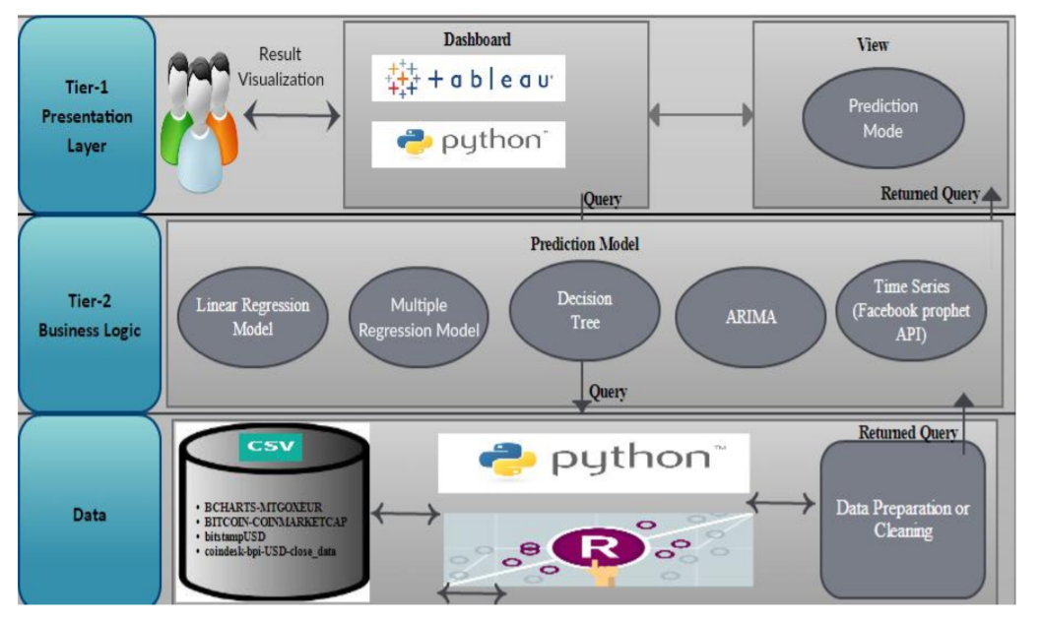
SYSTEM ARCHITECTURE:

Slide 12
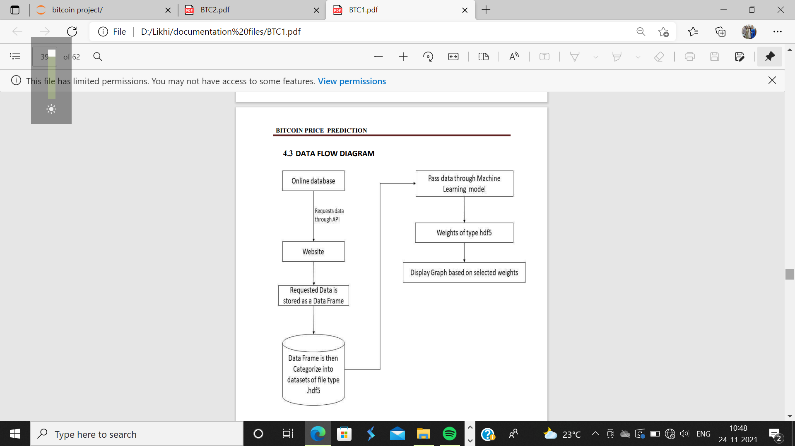
DATA FLOW DIAGRAM:

Slide 13
MODULES :
The modules involved in this project are:
Dataset collection and cleaning.
Feature Extraction
Stationarity
Seasonal Decomposition
Normalization:

Slide 14
Dataset collection and cleaning
The dataset consists of day-wise bitcoin statistics from 29 Apr ‘13 to 1 Oct ‘20.
The unit used for the price is USD.
The data was taken from coinmarketcap .
The data was pretty consistent without null and missing fields, so there was no need for cleaning the dataset.

Slide 15
2. Feature Extraction
The dataset initially consisted of various attributes that can be listed as 'time_open', 'time_close', 'time_high', 'time_low', 'USDopen', 'USD.high', 'USD.low', 'USD.close', ‘USD.volume', 'USD.market_cap' and 'USD.timestamp’.
Mean = (USD.low+USD.high) /2
Close Price — It is the market close price for currency for that particular day.
High Price — It is highest price of currency for the day.
Low Price — It is the lowest price for currency for that day.
Open Price — It is market open price for currency for that day.
Volume — The volume of currency that is being in trade for that day.

Slide 16
3. Stationarity
A time series is said to be stationary if it does not show seasonal or trend effects on an aggregate level
This can be observed by analyzing the seasonal decomposition of the time series attribute to be forecast (i.e. Mean in our case).
So, to check if data is stationary or not, we used the Augmented Dickey-Fuller (ADF) test. It is the most popular statistical method to find if the series is stationary or not. It is also called as Unit Root Test.
The dataset initially was not stationary. A differencing technique was applied to make it stationary for ARIMA models to utilize their full potential.

Slide 17
4. Seasonal Decomposition
Seasonal Decomposition separates a time series’ variations into three main components
Trend: This depicts the increase or decrease in the series giving a general idea or trend about the aggregated variations.
Seasonality: This identifies the repeating short-term variation cycle in the series.
Residual: This depicts the random variation in the series sometimes also known as the noise.

Slide 18
5. Normalization
We have performed min-max scaling for Normalization which scales the attributes to the range (0,1).
This is done by dividing the difference between an observation and the attribute’s minimum value by the range of that attribute, i.e.
X_normalized = (X-Xmin) / (Xmax-Xmin)

Slide 19
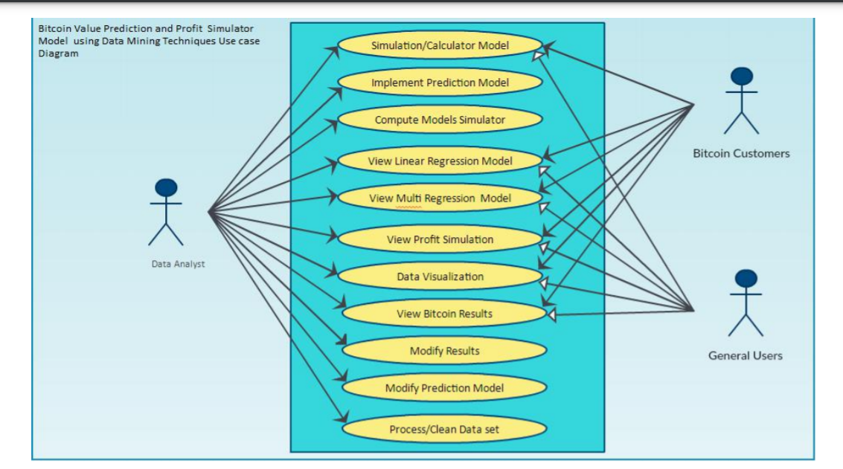
USE CASE DIAGRAM:

Slide 20
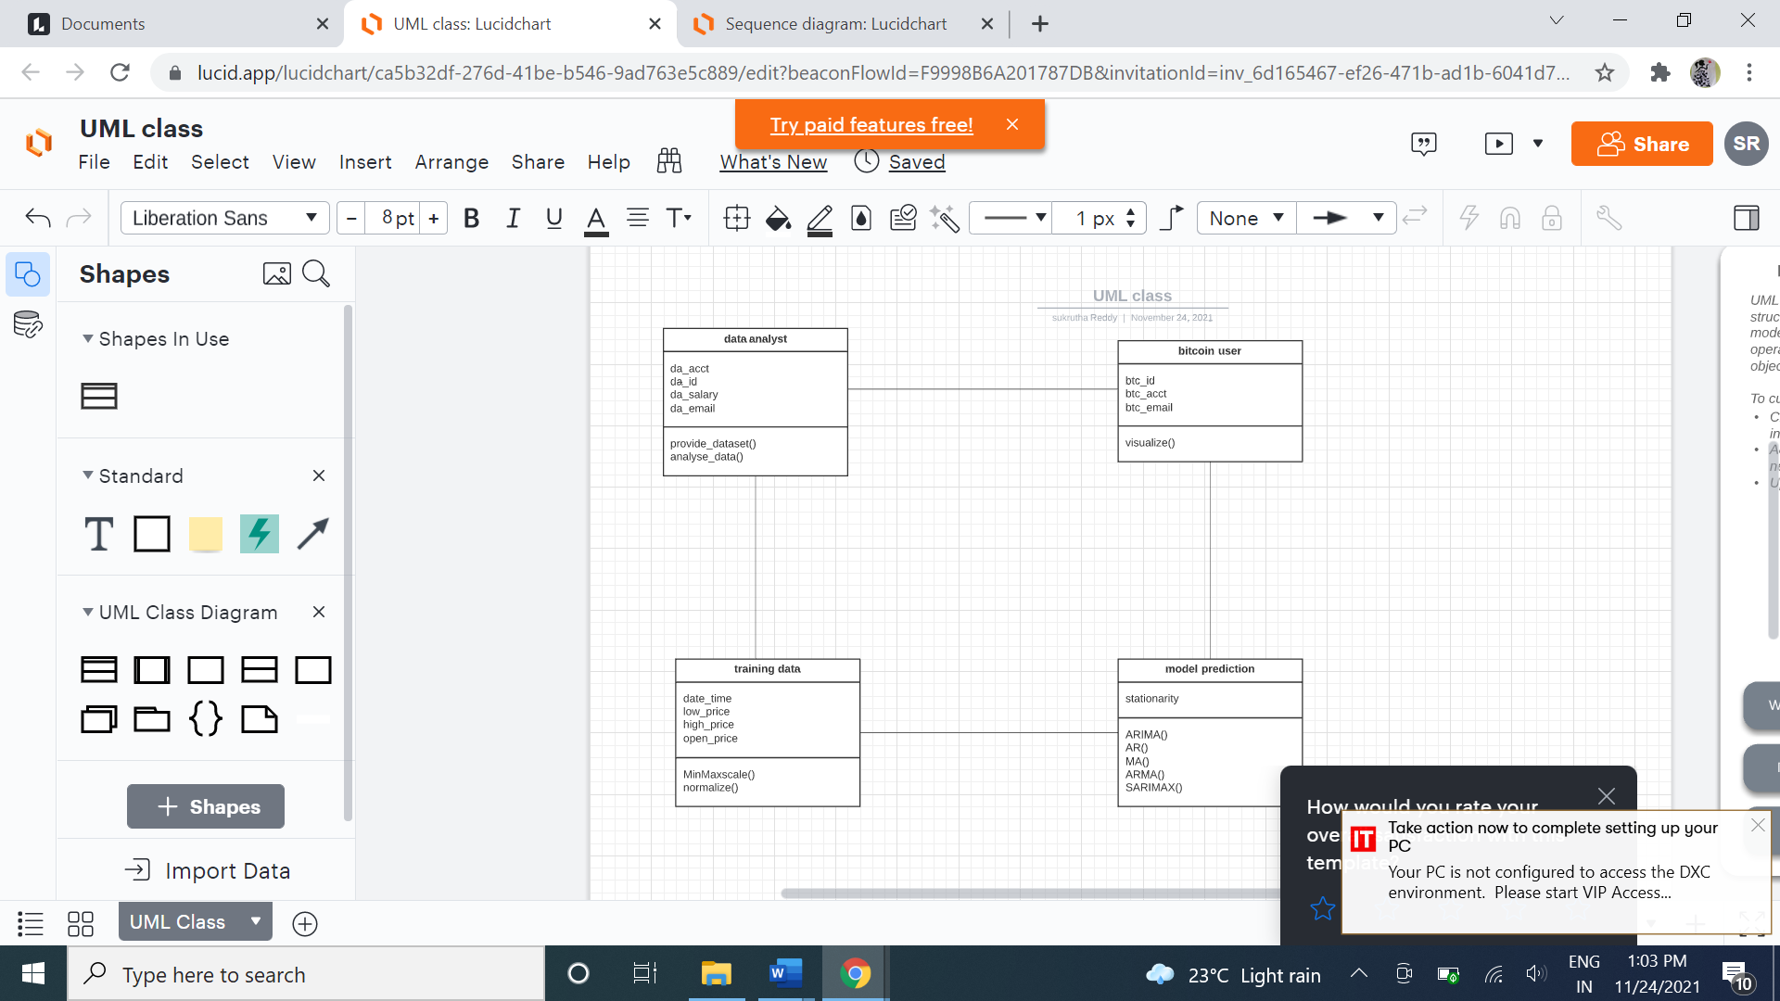
CLASS DIAGRAM:

Slide 21
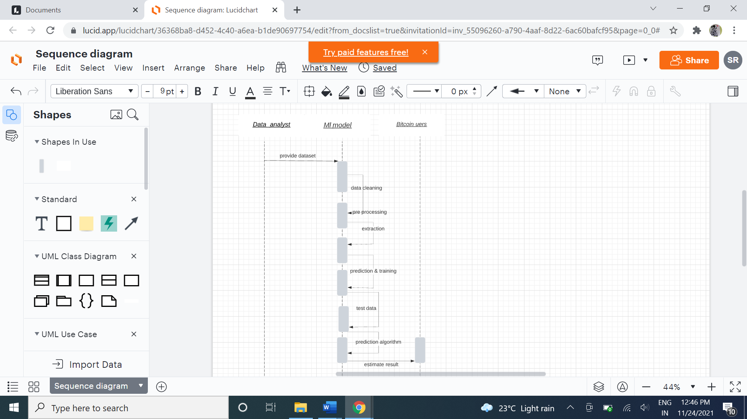
SEQUENCE DIAGRAM:

Slide 22
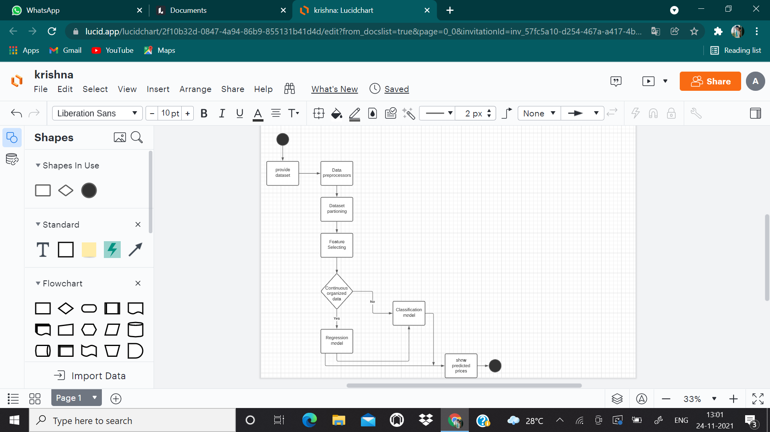
ACTIVITY DIAGRAM:

Slide 23
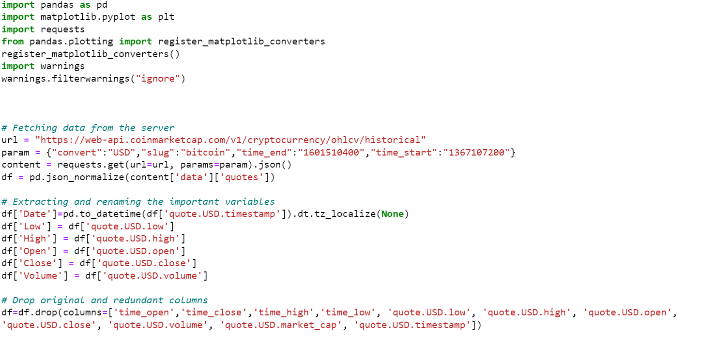
Sample Code

Slide 24
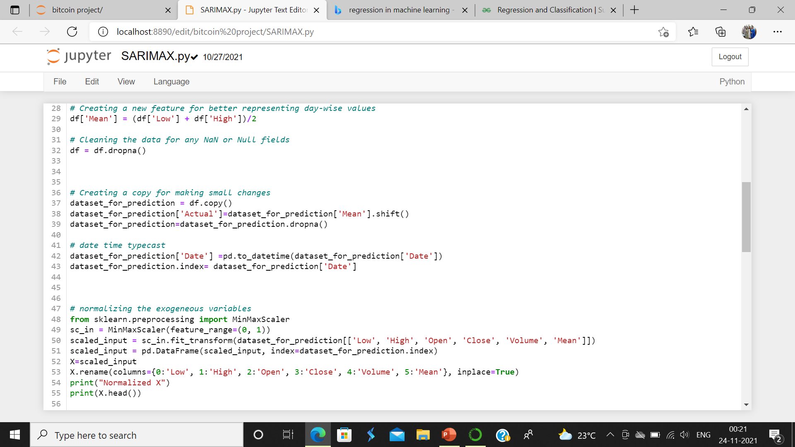

Slide 25
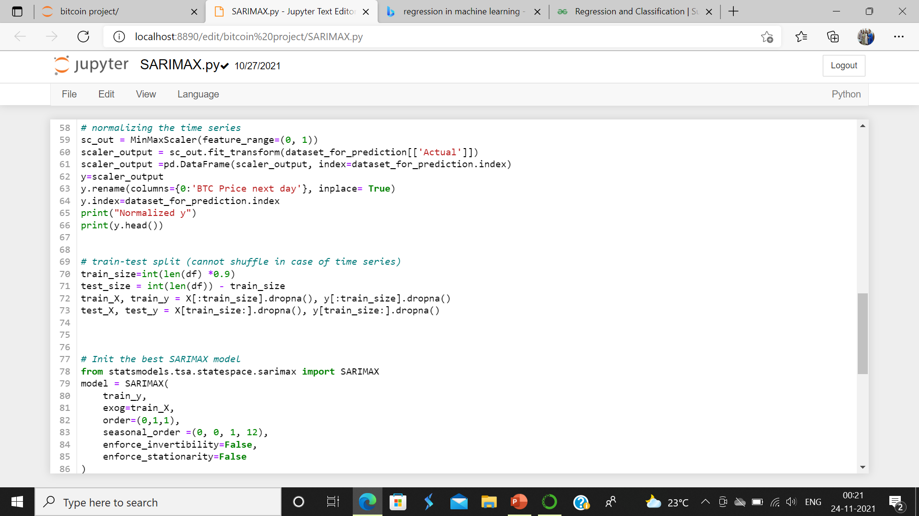

Slide 26
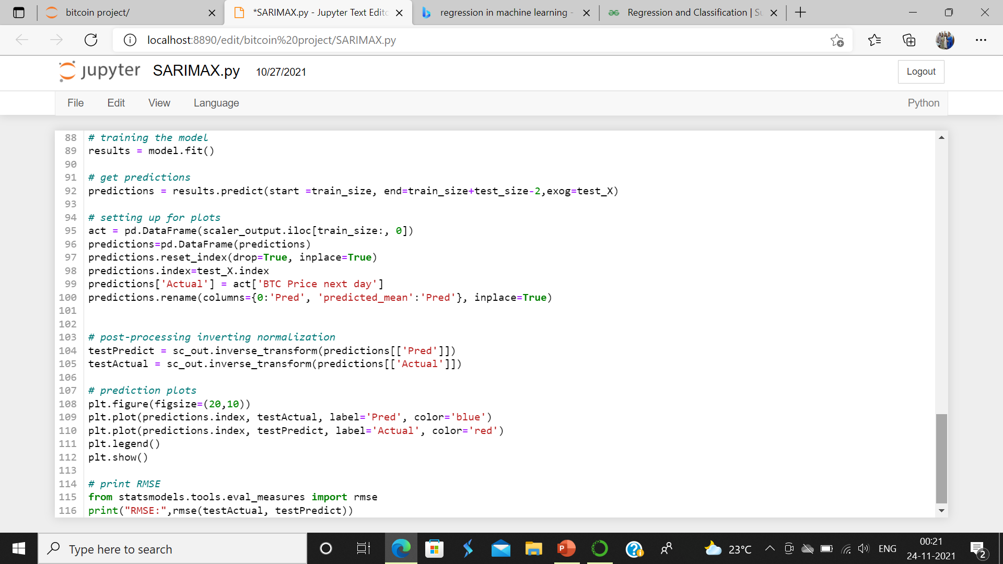

Slide 27
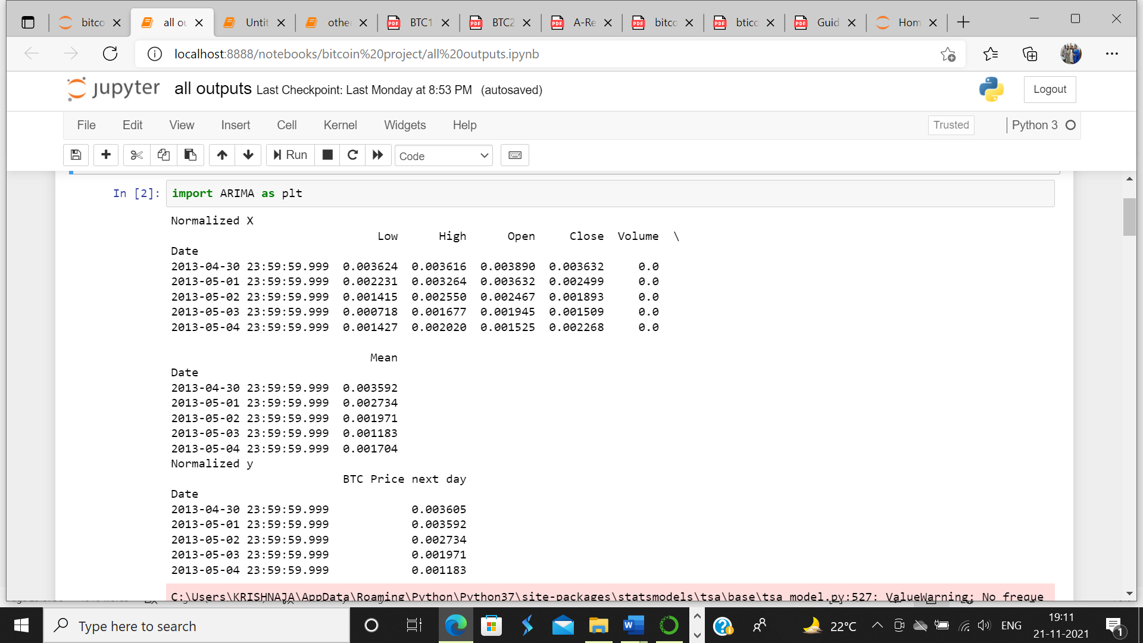
Result

Slide 28
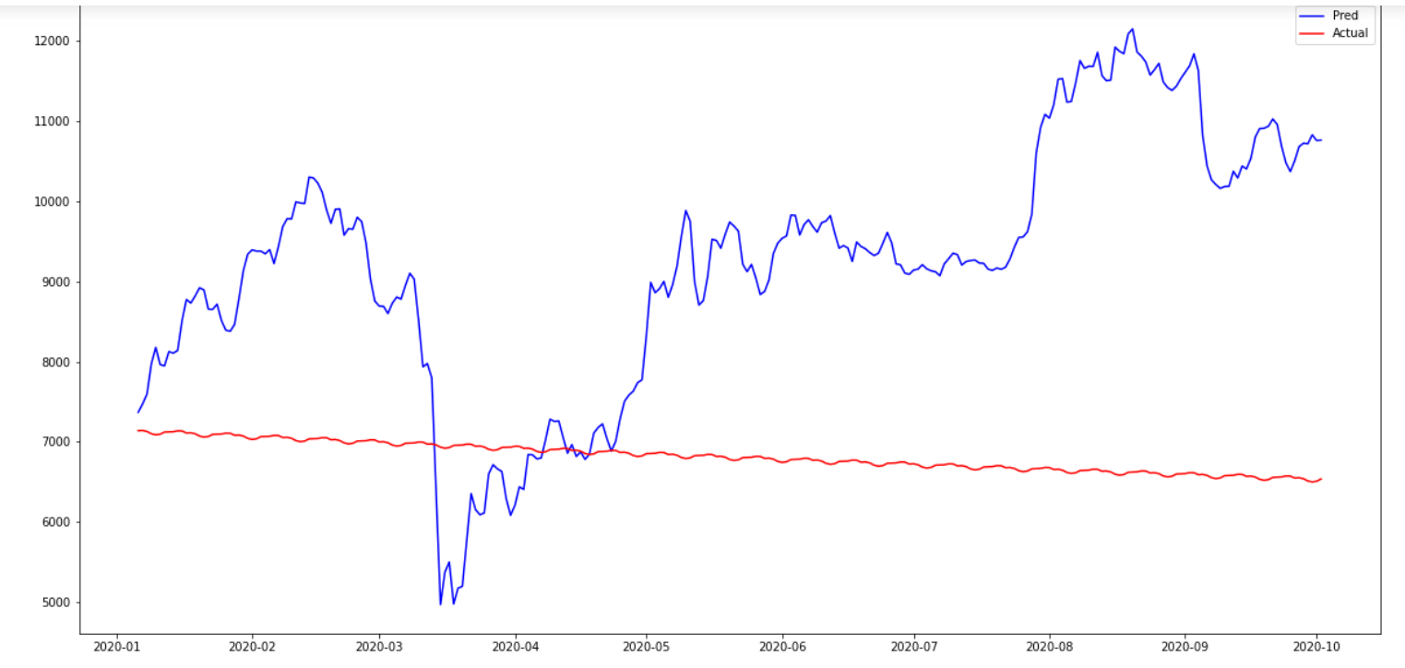
Result

Slide 29
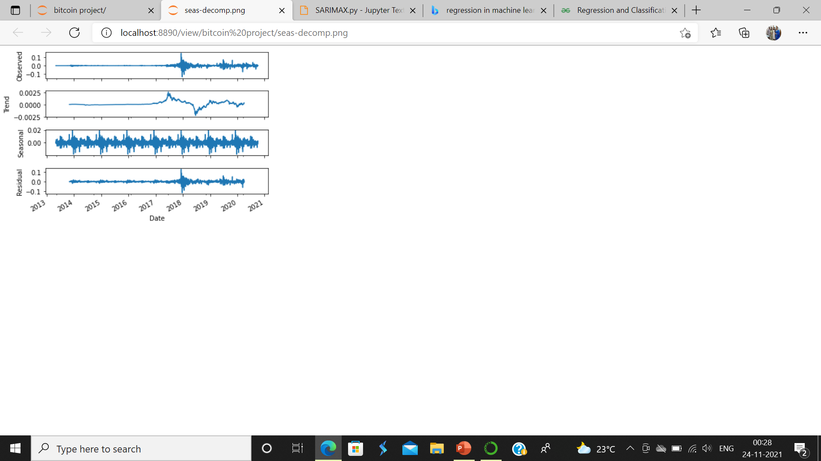

Slide 30
CONCLUSION:
There has been much learning achieved by this project, not only related to course work but in a different direction in the field of machine learning.
This project expanded the knowledge on topics like regression methods and made us learn the difference between routine regression problems and the prediction/ forecasting problems.
It made us encounter algorithms specially made for forecasting, i.e time series algorithms like ARIMA, VAR and GARCH. It also taught us how to analyze time-series data with seasonal decomposition, further breaking down to a better understanding of the SARIMAX model, which uses this functionality to predict the best values.

Slide 31
Future Enhancements:
Facilities for maintaining large amounts of data.
Access of data through Mobile devices.
Use of a good software.
More interactive user interface.
Facilities for Backup creation.

Slide 32
References:
[1] Rob J Hyndman, “Forecasting: Principles and Practice,” no. September, 2014.
[2] Agrawal J, Chourasia V, Mittra A. 2013. State-of-the-art in stock prediction techniques. International Journal of Advanced Research in Electrical, Electronics and Instrumentation Engineering 2(4):1360–1366.
[3] Kazem A, Sharifi E, Hussain FK, Morteza S, Hussain OK. 2013. Support vector regression with chaos-based firefly algorithm for stock market price forecasting. Applied soft computing 13(2):947–958.
[4] R. A. Juanda, Jondri, and A. A. Rohmawati, “Bitcoin Price Prediction by Using Recurrent Neural Network,” eProceeding Eng., vol. 5, no. 2, pp. 3682–3690, 2018.

Slide 33
QUERIES….?

Slide 34
THANK YOU

